Slide 1
Talent Management
Who’s driving your career?

Slide 2
 | Topic | Presenter(s)
1 | Introduction | Human Resources
2 | It’s YOUR Career–Time to Take the Wheel | Public Service University
2 | Talent Management – Driving to Success
 | Profile Management
 | Performance Management
3 | S.M.A.R.T. Performance Goals
4 | Career Goals
5 | Starting the Journey
 | Training Support
 | Contact List
 | Quiz Instructions

Slide 3
Introduction
HR Remediation Projects Initiative:
Employee Self Serve
Open Enrollment
DIHRT (Department Initiated HR Transactions)
Administrative Instruction 7-32-1
Employee Work Plan (EWP)
Administrative Instruction 7-32-2
Performance Evaluation Guide (PEG)
Effective February 2006
Mandatory, but compliance was difficult
Process cumbersome

Slide 4
Talent Management replaces EWP’s and PEG’s
No more paper performance evaluations. Completed online in PeopleSoft.
Identifies employee contributions to achieving goals
Supports two-way communication: Manager and Employee
Increases Employee Involvement: Input on career goals and self-review
Staggered Performance Evaluation Due Dates
Driven by Employee Anniversary Dates (not Fiscal Year start/end)
What’s New?
Five Point Rating Scale
2 Levels of Manager Approval
Manager Dashboard
Checkpoints
Compliance tracking by HR
Expectation: 100% Participation

Slide 5
It’s YOUR Career – Time to Take the Wheel

Slide 6
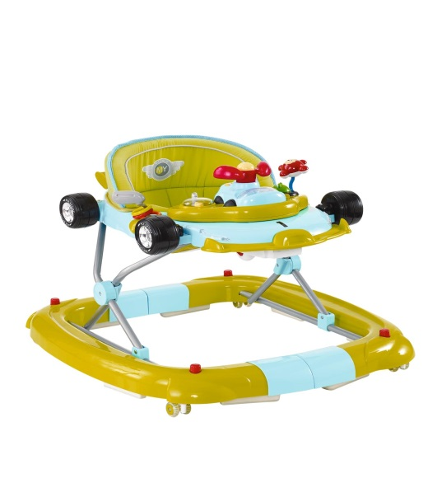
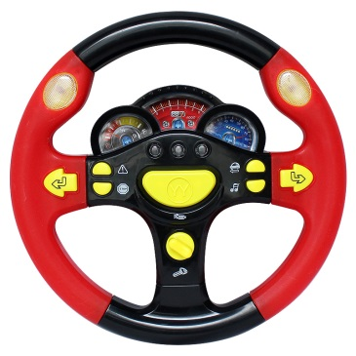
Memory Lane
Beep, Beep!

Slide 7
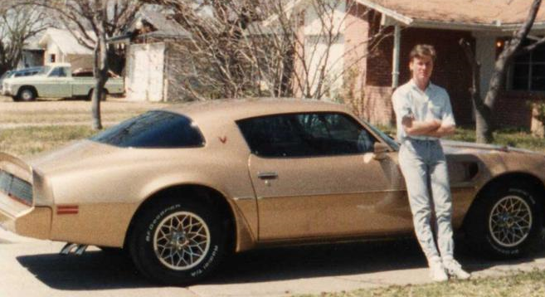
How you felt on the inside
How you looked on the outside
When you weren’t driving
When you were driving

Slide 8
Getting from Point A to Point B
Point A: Can’t Drive
Point B: Licensed Driver
Driver’s Ed Class
Driving Test
Permit
Studying
Practice Driving

Slide 9
Is driving your car as fun as it used to be?
Probably not, but it’s still just as important to keep control of the vehicle as it was the very first day.
You are the driver.
You decide where to go and how to get there.
The car is the tool you use to achieve your goal.

Slide 10
Talent Management
Career Driver’s Handbook
Driving to Success

Slide 11
What is Talent Management?
There are two parts to Talent Management
Profile Management + Performance Management
Part One: Profile Management
Person Profiles track military service, training, education, as well as, licensing and certifications of any type (personal or professional).
Help supervisors track certification expirations and employee KSA’s (Knowledge, Skills and Abilities).

Slide 12
Driving Your Career
Person Profiles are created by YOU.
Person Profiles are about YOU.
Person Profiles SHOWCASE YOU!
There is more to YOU than a Job Description!
Licenses
Volunteer
VETERAN
Multi-Lingual
College
Degree

Slide 13
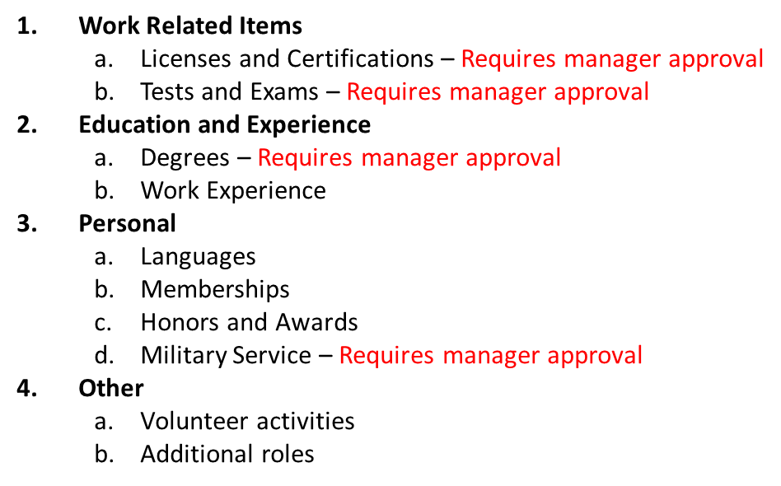
Create Your Person Profile
My Current Profile
Several items require manager approval.
Upload supporting documentation to prove the validity
with your submission for these items.

Slide 14
Person Profile Responsibility
Create your Person Profile
Enter all work related licenses and certifications with their expiration dates
The system will alert you and the manager when the expiration date is approaching so that they do not expire
This eliminates manual tracking efforts and employee downtime

Slide 15
Part Two: Performance Management
Performance Management is an ongoing, year round ACTIVE system.
PeopleSoft is the tool that facilitates the communication process with these important aspects:
Communicating the business direction
Planning performance
Managing performance
Evaluating performance
Career Development
Shared Accountability
Two-way Communication

Slide 16
Performance Management Timeline
Starts on Employee Anniversary Date
Checkpoint 1
Checkpoint 2
Ends Day before next Anniversary Date

Slide 17
Performance Management Roles
MANAGER ACTIVITIES
Evaluating Manager
Creates Document Adds City Goal(s) – Not Rated Reviews Core Values with Employee at beginning of year Rates & Comments at end of year Sets & Reviews Performance Goals with Employee at beginning of year Rates & Comments at end of year Sets Career Goals with Employee Documents & Comments Conducts Checkpoints End of Year Review & Shares with Employee Feedback from Employee Finalizes Performance Document
Approving Manager
Compliance Gatekeeper Review and approves/closes evaluation
EMPLOYEE ACTIVITIES
Reviews City Goals (Not Rated) Reviews Core Values (Rated) Reviews & Discusses Performance Goals with Manager (Rated) Sets Career Goals with Manager Participates in Checkpoints with Manager throughout year End of Year: Conduct Self-Review, Ratings & Adds Comments Receives Manager Review Provides Feedback/Comments Acknowledges Final Review/Rating

Slide 18
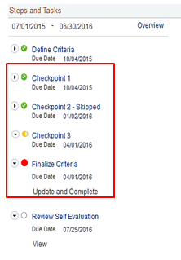
Progress is tracked by the system:
Leads the manager through the steps.
Shows due dates for each of the steps.
Due dates trigger alerts.
Sub-steps also display.
Steps in progress display as yellow.
As each step is completed, a green checkbox appears.
If the step is late, the icon will show red.
If a checkpoint is skipped, the step shows as skipped.
Green = Completed
Yellow = In Progress
Red = Overdue

Slide 19
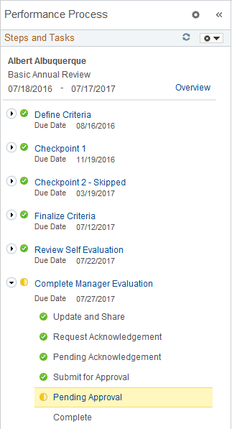
Beginning Process
Manager creates Performance Document
Manager adds City Goal to the document
Manager reviews
Core City Values
Manager adds Performance Goals to the document
Manager adds Career Goals to the document
Reviews the Performance Document with the Employee

Slide 20
During the Year
Manager & Employee:
Add Performance Notes (Ongoing)
Checkpoint 1: Manager Comments & Shares
Employee reviews comments and adds comments
Checkpoint 1: Complete
Checkpoint 2: Manager Comments & Shares
Employee reviews comments and adds comments
Checkpoint 2: Complete

Slide 21
End of Year
Employee: Self-Review
Manager: Conducts Review
Manager & Employee: Discuss Review & Ratings
Employee Acknowledges
Evaluation
Employee’s Manager
Finalizes Evaluation
Approving Manager: Reviews & Approves or pushes back until complete
Annual Evaluation Closed

Slide 22
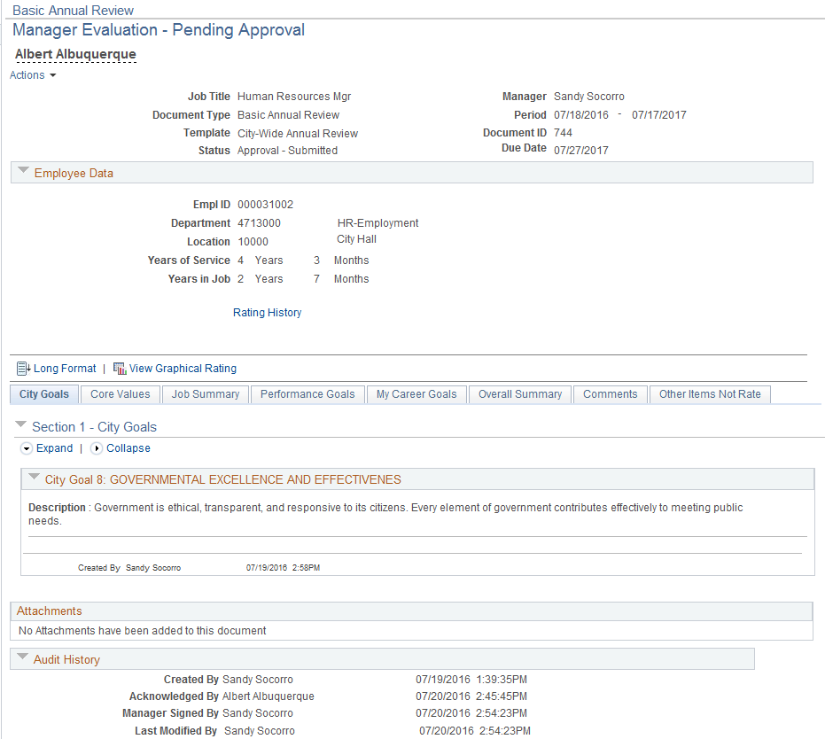
Performance Document
Tabs:
City Goals
Core Values
Job Summary
Performance Goals
My Career Goals
Overall Summary
Comments
Attachments can be added to the document by the Evaluating Manager Only.
Audit History on the bottom of every document.

Slide 23
New Rating Scale
5 Point Rating Scale
Unsatisfactory Performance
Needs Development
Meets Expectations
Exceeds Expectations
Exceptional Performance
There are two Rated Sections:
Core City Values
Performance Goals

Slide 24
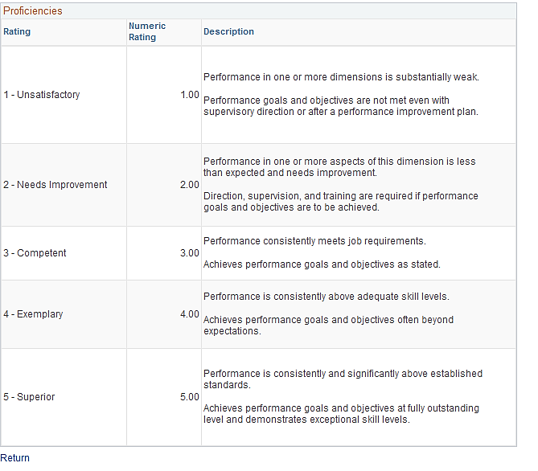
View of the 5 Point Rating Scale

Slide 25
Additional Performance Tools
Ability to Add Performance Notes all year
Advantages:
Performance Notes are Private
Jogs your memory about highlights/successes
Quick access to copy and paste to your Performance Document
Helps you support your self-review ratings
Assists in evaluation discussion with manager
Workflow E-mails
System generated e-mail reminders/updates
Directs manager and employee to the next steps in process
Provides a URL link to take you to the Performance Document

Slide 26
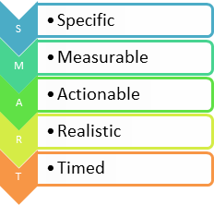
SMART Performance Goals
S
M
A
R
T

Slide 27
What is a SMART Performance Goal?
A carefully crafted, comprehensive statement about what the employee intends to accomplish throughout the year
An individual action plan
Advantages of SMART Performance Goals
Provides guidance and direction for work
Links employee accomplishments to organizational objectives/goals
Clarifies expectations for the employee and supervisor
Improves performance

Slide 28
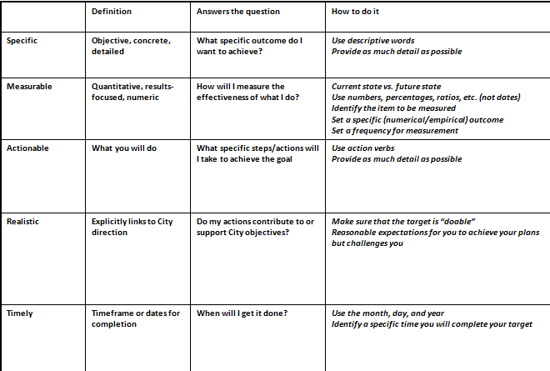
Elements of SMART Performance Goal
Example:
Reduce time from answering call to first responder call-out by 10% by 6/30/2017 in order to support Public Safety.

Slide 29
Manager: Providing Direction
Sets the Performance Goals and adds them to the Performance Document
Communicates the goals and responsibilities to employee
Makes sure that the employee understands the goals
Answers employee questions to clarify.
The manager is responsible to create the goals, but employee is responsible for their performance.
Comments on progress at Checkpoints
Rates and Comments at end of performance year

Slide 30
Employee: Taking the Wheel
Reviews the Performance Goals set by the manager
Understands goals and their associated responsibilities
Asks questions until the goal is clear
Responsible for performance related to meeting the Performance Goals
Comments on progress at Checkpoints
Conducts Self-Review at end of performance year
Managers may work with employees to create the goals, but managers have the final responsibility to set the Performance Goals.

Slide 31
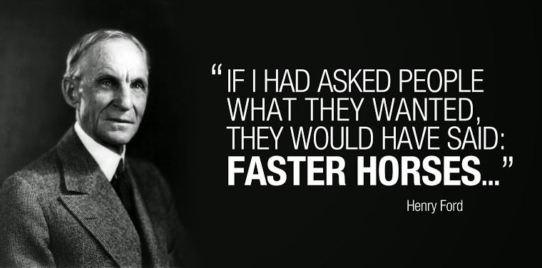
Career Goals

Slide 32
Where do you want to be in 1 year? 5 years? 10?
Career Goals help you get there!
Advantages of Career Goals
Assists in achieving the Performance Goals
Enhances your Knowledge, Skills and Abilities
Uniquely YOURS! Tailored to help you meet your personal career goals.
Helps you keep your current career on track
Helps prepare you for your career future

Slide 33
Questions to help create a Career Goal
Development Target
What do I need to improve?
How to Achieve
What Development Method(s) will I use?
Measurement
How will I measure my improvement?
Completion Date
When will I complete my Development Target?
Results
What was the impact on my performance?
Managers will work with employees to create meaningful Career Goals, but managers have the final responsibility to enter them into the system.

Slide 34
Career Development Opportunities
Advisory Committees
Apprenticeships
Certifications
Challenging/Stretch Work Assignments
Classroom Training
Conferences
Cross Training
Degree Programs
Internships
Job Rotation
Job Shadowing
Job Swap
Mentoring
Online Learning
On the Job Training (OJT)
Professional Association Activities
Reading (Book Club)
Research Projects
Self Study
Skill Development
Special Projects
Task Groups
Volunteer Activities

Slide 35
Career Goals
Every employee should have a minimum of two Career Goals
Every employee should have a career goal to complete their Person Profile
Career Goals are NOT RATED, but they are Documented (Met or Not Met)
They are not part of the performance rating

Slide 36
Starting the Journey

Slide 37
Training Support for Talent Management
Public Service University -
Talent Management Website
Classroom sessions: SMART Targets, etc.
On-Demand Online Courses – Activity Based
Courses in See It! and Try It! mode
System Process Documents (Detailed Job Aids)
Job Aids (Quick Steps)
Open Workshops

Slide 38
Contacts
Department Subject Matter Experts (identified by Directors)
Department HR Coordinators
Public Service University, 768-3200
DTI Help Desk, 768-2930
Password resets & system issues

Slide 39
Talent Management
Quiz
There are two parts to complete before you will receive course credit:
Part One: Complete training session
Attended the training session
Part Two:
Complete Quiz (final step)
You will receive an e-mail with the link to the Quiz. Complete the Quiz to receive credit.

Slide 40
Talent Management

